Slide 1
Humidification
Group #3
Adil Feratovic, Hussein Rezk, Anna Cai, Aaron Casas
Chemical Engineering Lab I
11/24/25

Slide 2
Introduction
The objective is to obtain the heat and mass transfer coefficients of water and air
Use the data collected to see how inlet temperature and the flow rates of air and water influence the heat and mass transfer coefficients
Analyze the experimental data by comparing it to data found in literature

Slide 3
Industrial Applications
Automotive Manufacturing: Sanding decks, engine testing cells, and spray paint booths
Data Centers: Used to prevent electrostatic discharge and provide low-cost cooling
Dust Suppression: Safeguards health of employees

Slide 4
Experimental Objectives
Measure temperature and humidity along the wet column
Determine the mass and heat transfer coefficients
Calculate and analyze NTU (number of transfer units) and HTU ( height of transfer unit)
Compute the Reynolds, Schmidt, Sherwood, and Lewis numbers
Examine how different air flows and temperatures affect performance
Compare experimental results with the theoretical Sherwood correlation

Slide 5
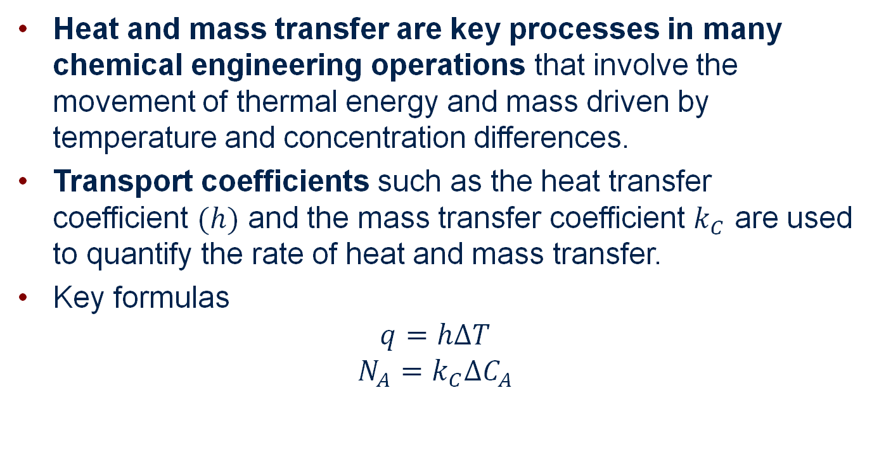
Theory
Heat and mass transfer are key processes in many chemical engineering operations that involve the movement of thermal energy and mass driven by temperature and concentration differences.
Transport coefficients such as the heat transfer coefficient $(h)$ and the mass transfer coefficient $k_{C}$ are used to quantify the rate of heat and mass transfer.
Key formulas
$$q=h∆T$$
$$N_{A}=k_{C}∆C_{A}$$

Slide 6
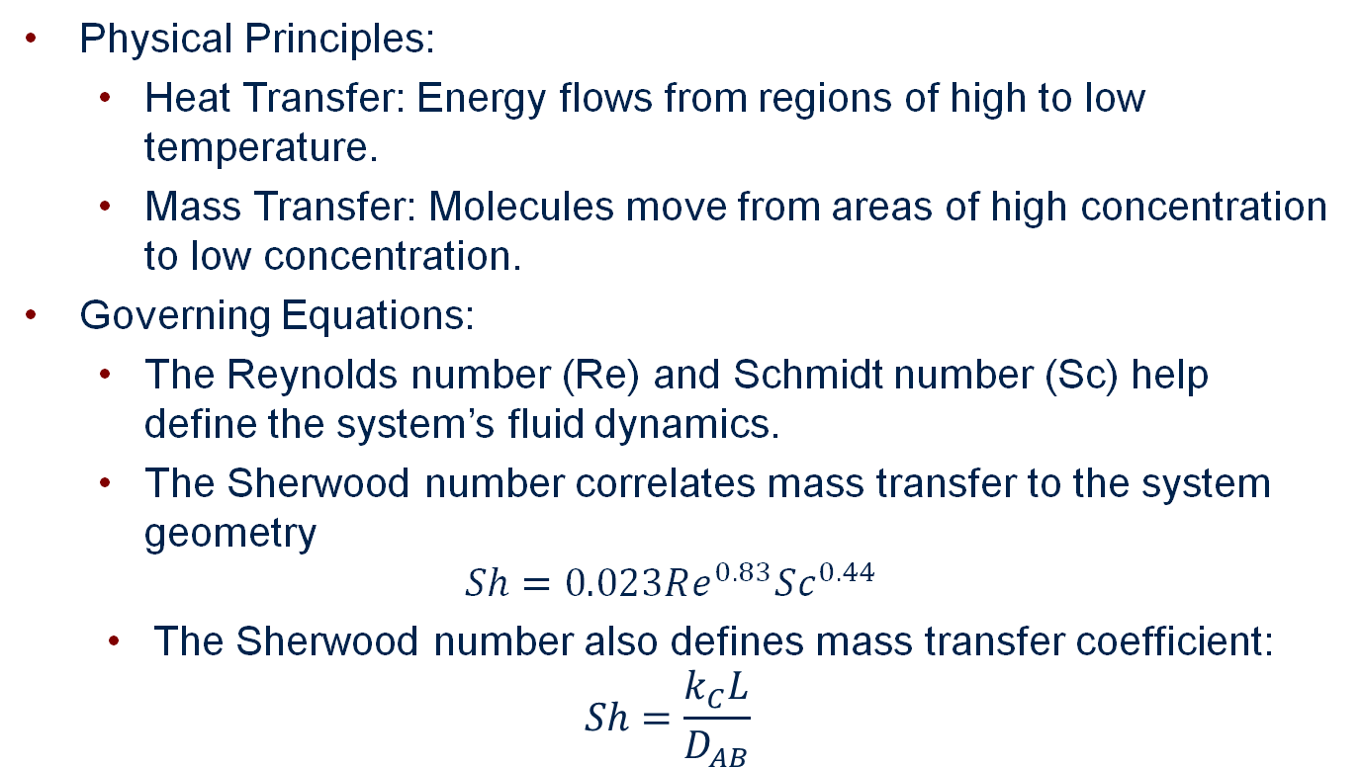
Underlying physical principles, governing equations
Physical Principles:
Heat Transfer: Energy flows from regions of high to low temperature.
Mass Transfer: Molecules move from areas of high concentration to low concentration.
Governing Equations:
The Reynolds number (Re) and Schmidt number (Sc) help define the system’s fluid dynamics.
The Sherwood number correlates mass transfer to the system geometry
$$Sh=0.023Re^{0.83}Sc^{0.44}$$
The Sherwood number also defines mass transfer coefficient:
$$Sh=\frac{k_{C}L}{D_{AB}}$$

Slide 7
Assumptions/limitations
Assumptions:
Steady-state conditions: Heat and mass transfer are assumed constant over time.
Dilute concentrations: Mass transfer coefficients are simplified for low concentrations.
Neglecting counter-diffusion: Simplifies equations for cases where the concentration of the diffusing species is small.
Limitations:
The Lewis relationship assumes that heat and mass transfer coefficients are equivalent in ideal conditions, which may not always hold true.
Complex flow patterns can introduce errors, and the theory assumes well-defined geometries like in a wetted-wall column.

Slide 8
Connection to experiment
Experimental Setup: A wetted-wall column is used to study heat and mass transfer between the gas (air) and the liquid (water) film.
Relevance of Theory:
The experiment tests the Sherwood number correlation by measuring the mass transfer rate.
It applies the heat and mass flux equations to quantify how efficiently heat and mass are exchanged between the phases.
The theory helps in determining transport coefficients using measured experimental data such as temperature gradients and concentration differences.

Slide 9
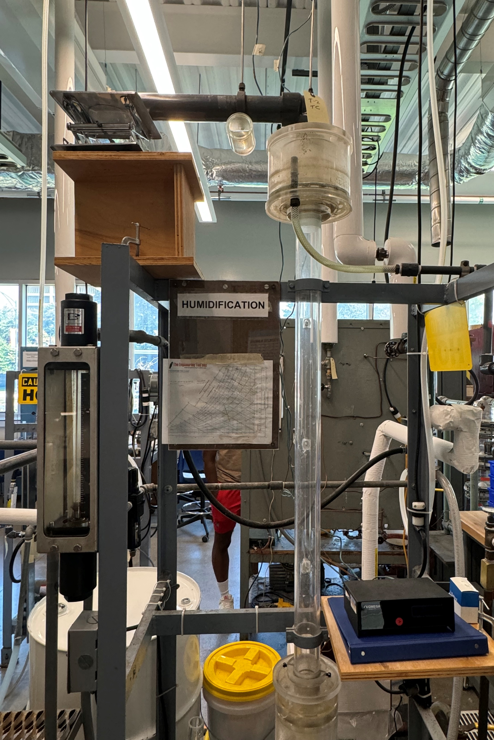
Apparatus
3
2
4
1
Number | Component
1 | Weir Disperses Water
2 | Thermocouple Dry Bulb Temp
3 | Thermocouple Wet Bulb Temp
4 | Air Outlet
5 | column
6 | Thermometer
7 | Air Rotameter
8 | Air Pressure Gauge
9 | Pump Switch
5
7
8
6
9

Slide 10
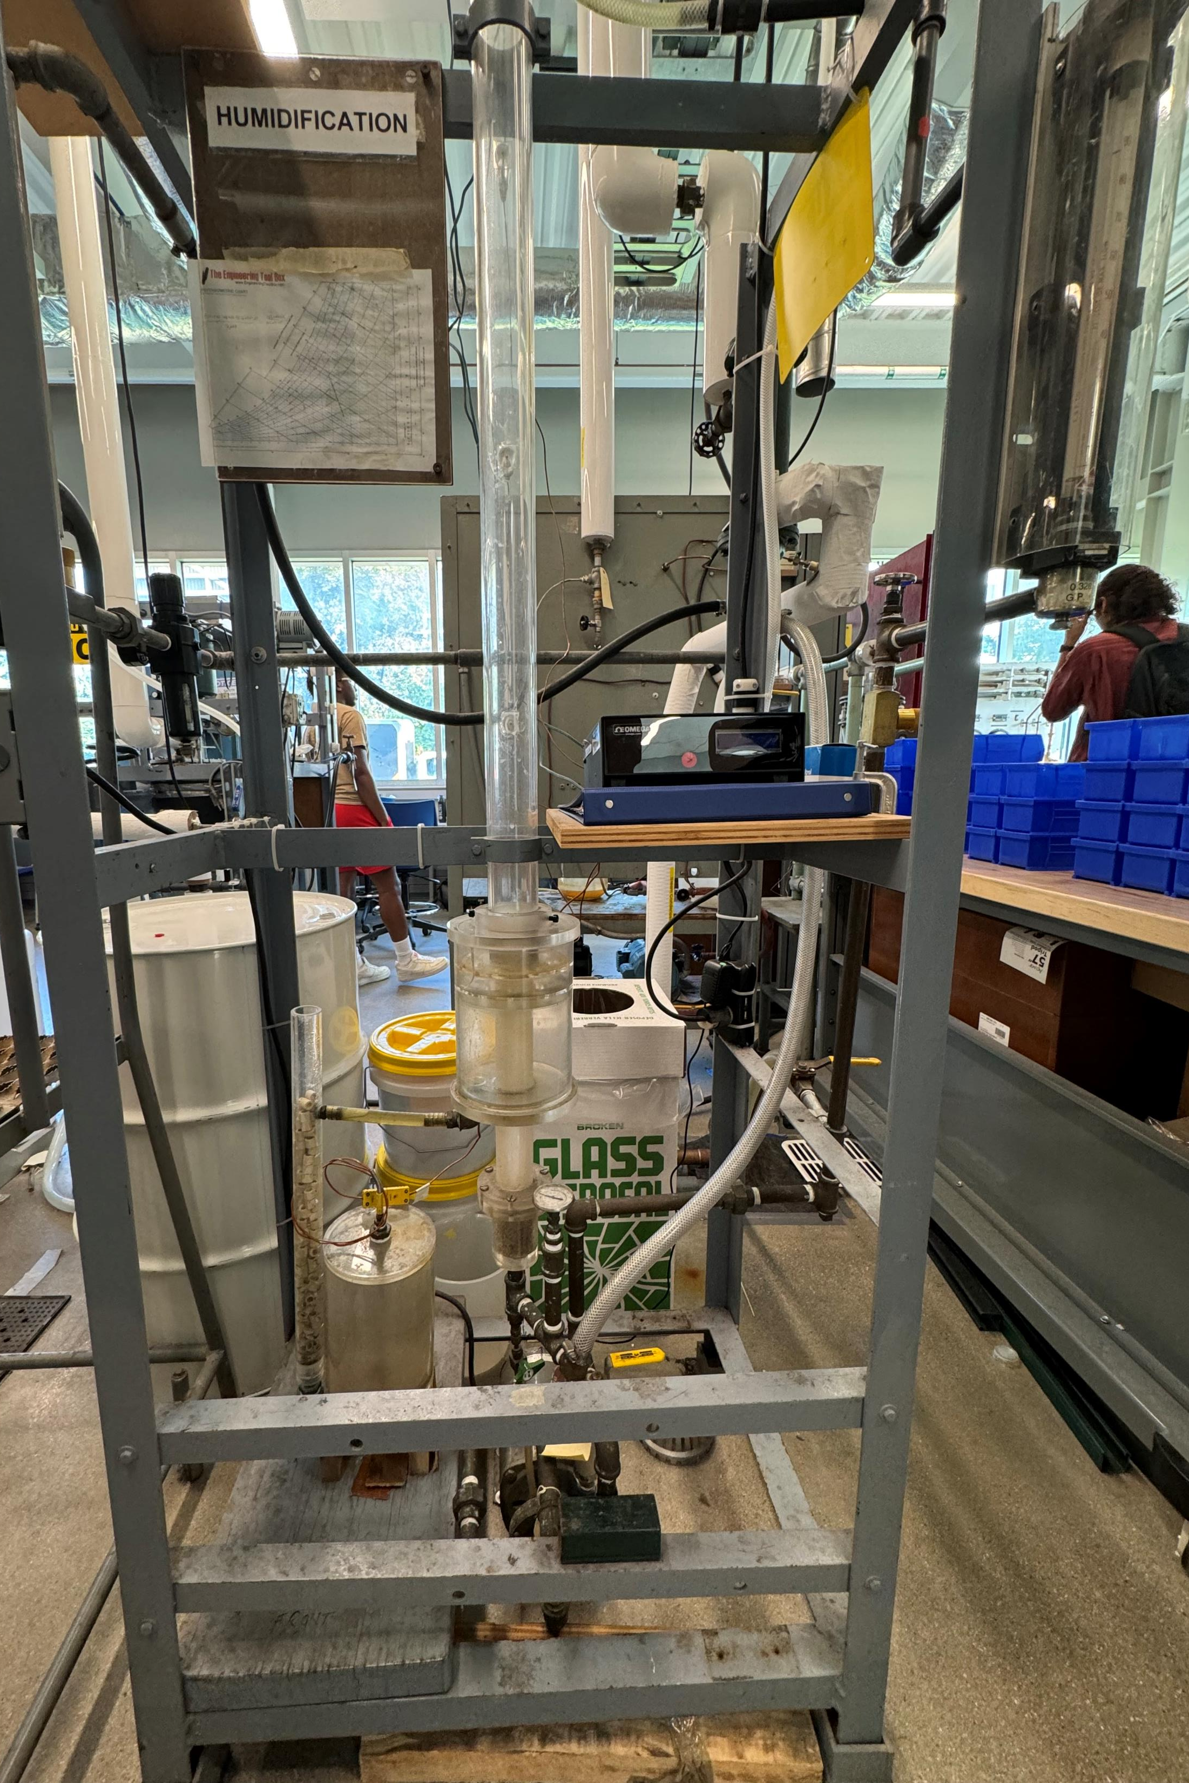
Apparatus
10
11
Number | Component
10 | Thermocouple Column Top
11 | Thermocouple Column Middle
12 | Thermocouple Column Bottom
13 | Thermometer Air Inlet Temp
14 | Pump
15 | Tank
16 | Thermocouple Tank
17 | Water Inlet
12
17
16
13
15
14

Slide 11
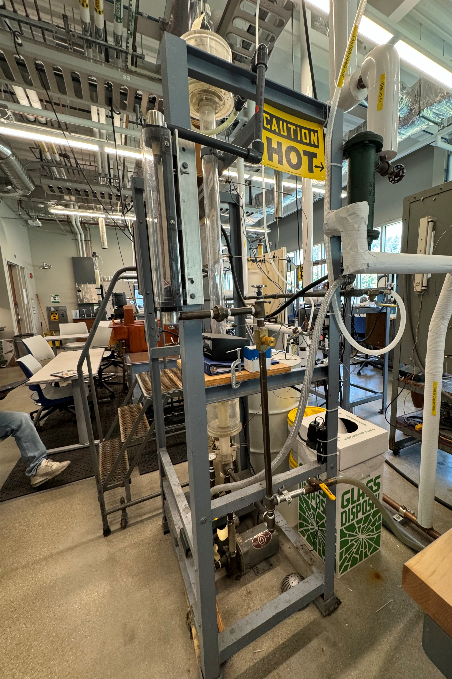
Apparatus
18
19
21
Number | Component
18 | Steam Valve
19 | Heat Exchanger
20 | Water Valve
21 | Water Rotameter
20

Slide 12
Material & Supplies
Deionized Water
Bucket
Funnel
Hygrometer
Heat Resistant Gloves
Steam
Air

Slide 13
Procedure
Select 3 temperatures, 3 air flow rates, and 3 water flow rates (one water flow rate will be zero)
First turn on the thermometer and record dry air data
While that this happening fill up the tank with deionized water
Next turn on the pump and wet the column
Keep increasing the water flow rate until water is around the entire column
Turn on steam to get to the required temperature
Record data for the different temperatures and flow rates once they are in steady state

Slide 14
Experimental Challenges
Running out of compressed air
Try to minimize the time spent at high flow rates
Getting the inlet air to the correct temp takes time, slowly increase steam until the desired temperature is reached
This could take a while
Check the inlet air temp every 5 minute
Double check units to ensure the correct data is collected
Make sure the column is properly wetted

Slide 15
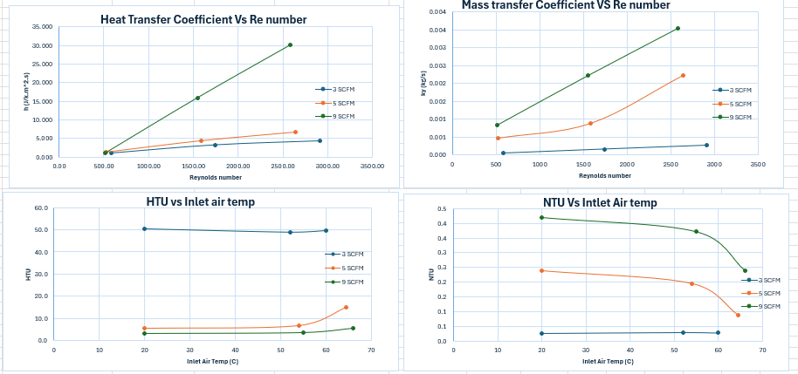




Results
NTU-driving force decreasing as higher inlet temp means higher moisture, making the difference smaller
-Yi-interface humidity
-Y humidity in or out

Slide 16
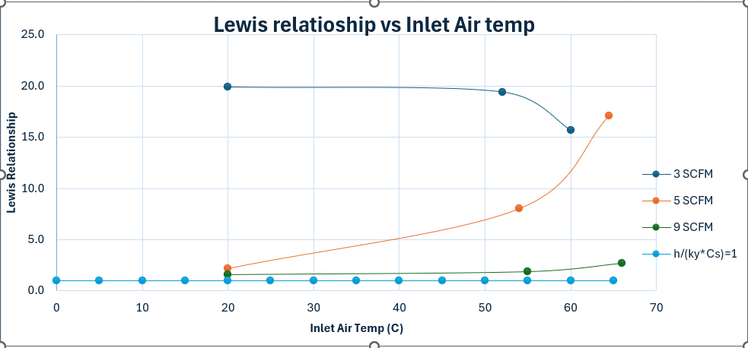

3SCFM- heat transfer dominate,5SCFM, mass transfer weakens,9SCFM heat and mass transfer are nearly balanced

Slide 17

Results continued
Further reinforces that higher Re number gives a better mass transfer coefficient

Slide 18
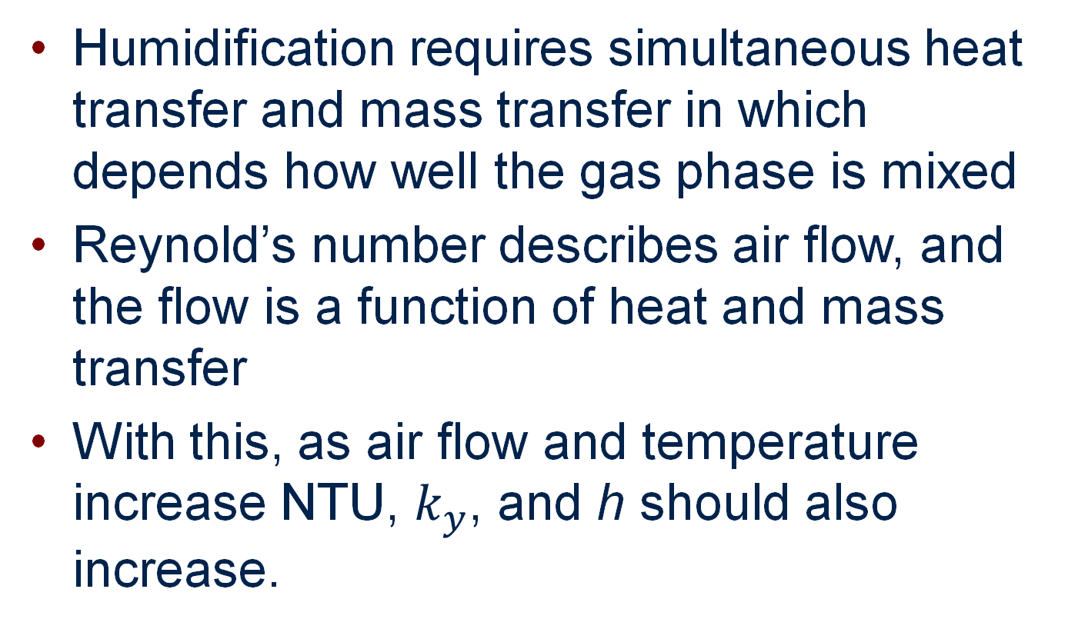
Discussion of Results
Humidification requires simultaneous heat transfer and mass transfer in which depends how well the gas phase is mixed
Reynold’s number describes air flow, and the flow is a function of heat and mass transfer
With this, as air flow and temperature increase NTU, $k_{y}$, and h should also increase.

